Slide 1
Chameleon Service Training
Dieburg, 06.-10.06.2016
Display Menu

Slide 2
Overview
Main Menu
Service Menu
Calibration

Slide 3
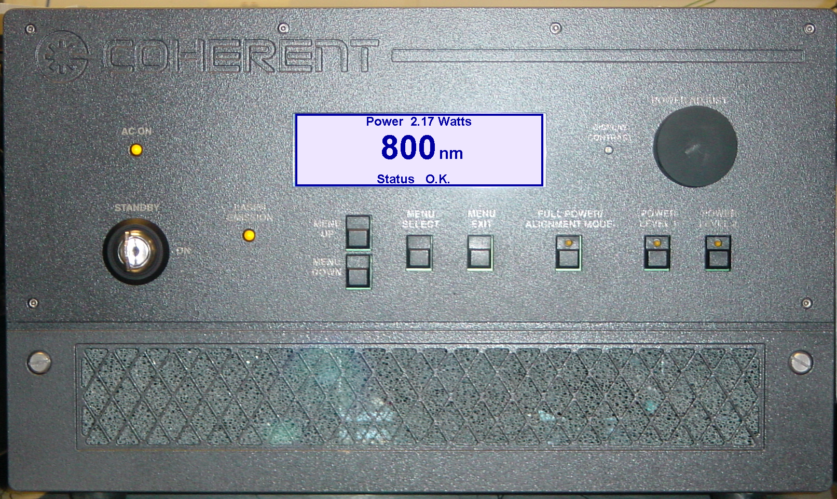
Power Supply Control Software

Slide 4
Software – MAIN MENU (1)
MAIN MENU
►System Diagnostic
System Shutdown
Alignment Mode
Initialise
Service
Displayed when in service mode
Main menu, displayed when menu/select
is pressed from the “Home” screen

Slide 5
Software – MAIN MENU (2)
MAIN MENU
►System Diagnostic
System Shutdown
Alignment Mode
Initialise
Service
SYSTEM DIAGNOSTICS
►RS-232 Baud Rate
System Information
Fault Screen
RS-232 Setting Baud rate 19200, 8,N,1 – adjusted
by using the power adjust knob
System information: PZT positions, wavelength
Chameleon hours and software versions for both
the Chameleon and Verdi
Fault screen: displays current faults

Slide 6
Software – MAIN MENU (3)
MAIN MENU
►System Diagnostic
System Shutdown
Alignment Mode
Initialise
Service
SYSTEM DIAGNOSTICS
►RS-232 Baud Rate
System Information
Fault Screen
RS-232 Setting Baud rate 19200, 8,N,1 – adjusted
by using the power adjust knob
System information: PZT positions, wavelength
Chameleon hours and software versions for both
the Chameleon and Verdi
Fault screen: displays current faults

Slide 7
Software – MAIN MENU (4)
MAIN MENU
►System Diagnostic
System Shutdown
Alignment Mode
Initialise
Service
System Shut down
Press Select to continue
Press Exit to abort
Initiates system cool down prior to total
system shut down

Slide 8
Software – MAIN MENU (5)
MAIN MENU
►System Diagnostic
System Shutdown
Alignment Mode
Initialise
Service
Alignment mode
EXIT when finished
Reduces laser output to a nominal low power in
order to facilitate alignment in applications where
the normal operating power is likely to cause damage

Slide 9
Software – MAIN MENU (6)
MAIN MENU
►System Diagnostic
System Shutdown
Alignment Mode
Initialise
Service
Initialize
Press Select to continue
Press Exit to abort
Basically the same as “Recovery” with old style Chameleons …

Slide 10
Software – SERVICE MENU (1)
MAIN MENU
►System Diagnostic
System Shutdown
Alignment Mode
Initialise
Service
SERVICE MENU
Calibration set up
Calibration
Home Stepper
Manual Control
Humidity
Settings
More straight forward, we will demonstrate
this in the lab

Slide 11
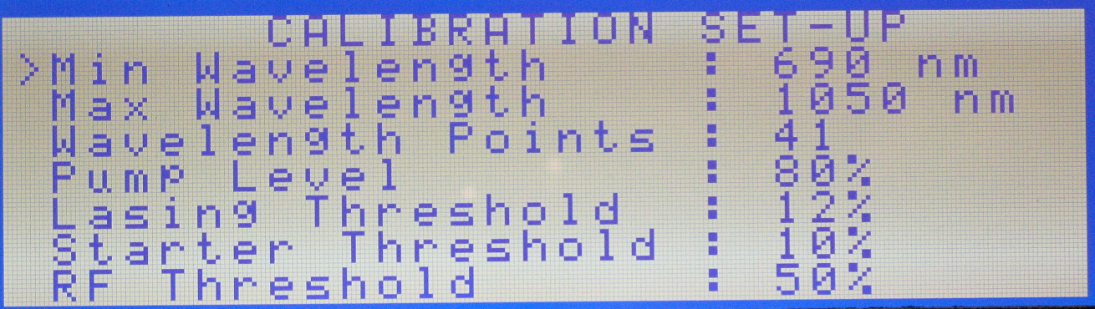
Software – SERVICE MENU (2)
CALIBRATION SET-UP

Slide 12
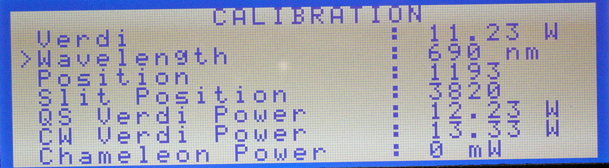
Software – SERVICE MENU (3)
CALIBRATION

Slide 13
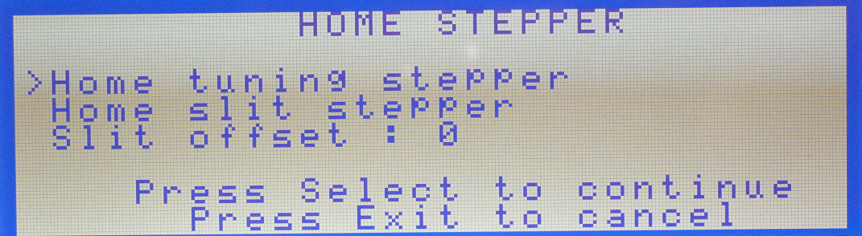
Software – SERVICE MENU (4)
HOME STEPPER

Slide 14
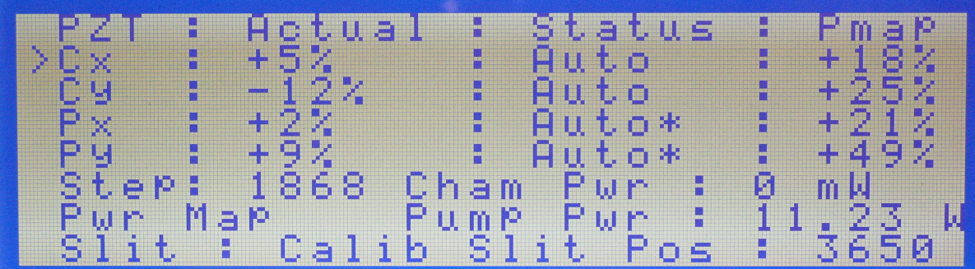
Software – SERVICE MENU (5)
MANUAL CONTROL

Slide 15
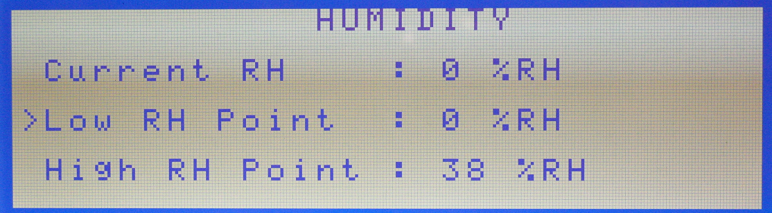
Software – SERVICE MENU (6)
HUMIDITY

Slide 16
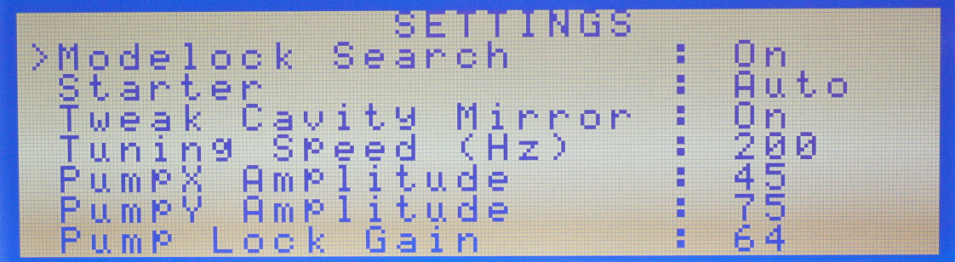
Software – SERVICE MENU (7)
SETTINGS

